Slide 1
Personal Project
April 11

Slide 2
Rules
Use ai to run the following prompt:
Write a project-level rule that forces a git commit after every modification. Only commit meaningful code changes — no intermediate artifacts, temp files, or generated outputs. No exceptions.

Slide 3
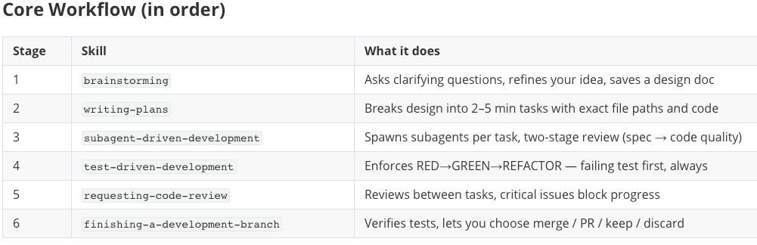
Use superpowers
A workflow framework for AI coding agents. It breaks the software development process into composable "skills" that trigger automatically at the right moment — no manual invocation needed.

Slide 4
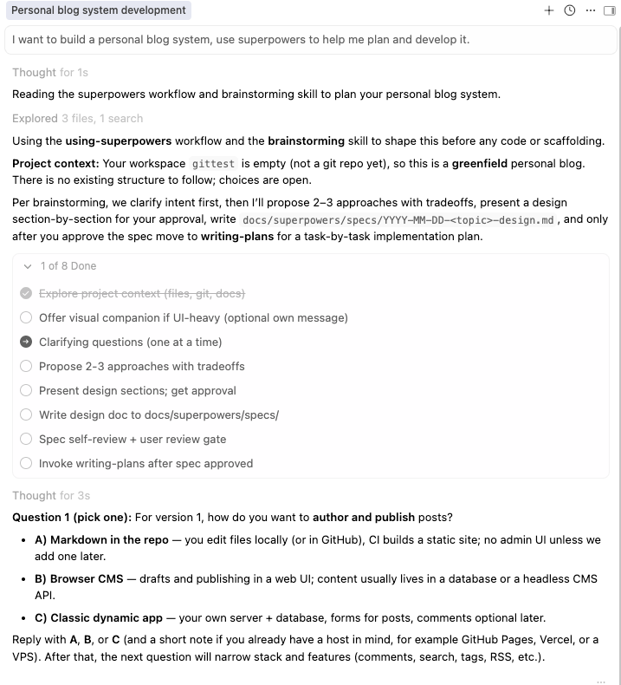
Superpowers Example
I want to build a personal blog system, use superpowers to help me plan and develop it.

Slide 5
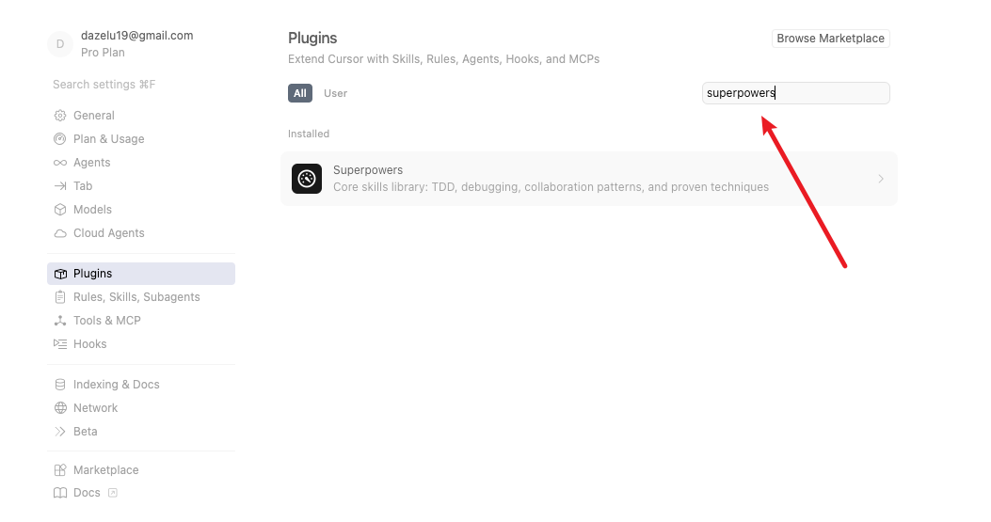
Install in cursor

Slide 6
Personal Projects
1. Problem Statement
What problem are you solving?
Who is the target user?
2. Goals & Scope
What does "done" look like? (define success clearly)
What is explicitly out of scope?
3. Design & Architecture
High-level system diagram
Key components and how they interact

